Slide 1


CAB SHARE
by Aman Srivastava
Supervised by-
Arpit Khandelwal

Slide 2


Problem
Problem faced by commuting students
Cost Inefficiency in Transportation
Limited Transportation Options and Connectivity
Lack of Shared Travel Options

Slide 3

Solution
Ride Sharing App
Reduced Expenses
Cab Share offers a centralized platform for students to connect based on their travel plans.
By sharing rides, individuals can split expenses, significantly reducing the cost burden of commuting.

Slide 4
Techstacks Used
Flutter
For cross-platform mobile application development
Firebase
For data storage and retrieval and user authentication

Slide 5
Features
User Authentication
Authentication for login/Signup process
User-Friendly Travel Cards
The app displays travel plans in a card format, making it easy for users to view and request
Request-Accept Mechanism
Users can request other travellers for sharing
Messaging and Notification
In-app messaging service for seamless communication and Notification for acceptance/message.

Slide 6

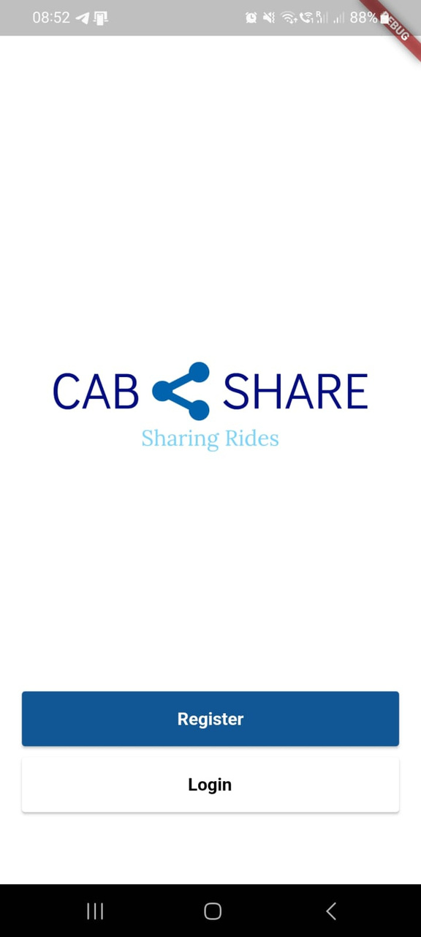
Login/Signup Page

Slide 7
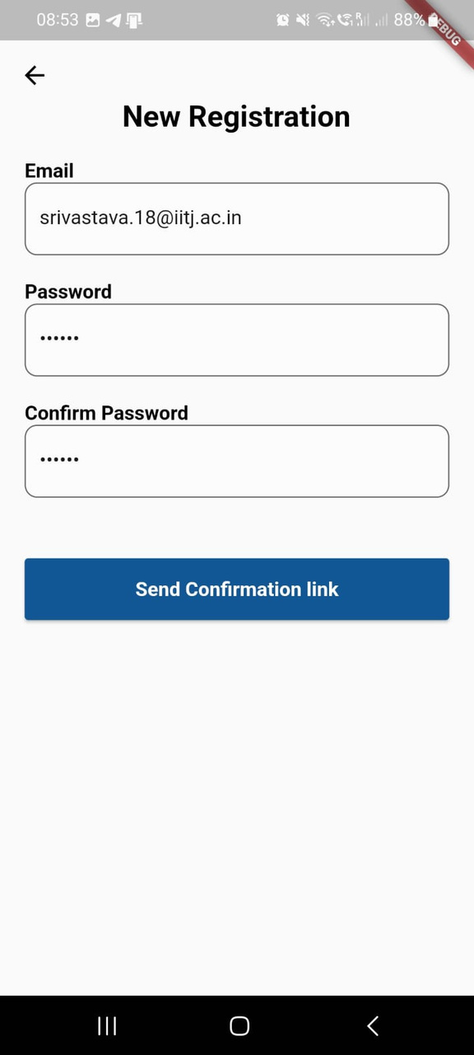
Signup Page

Slide 8
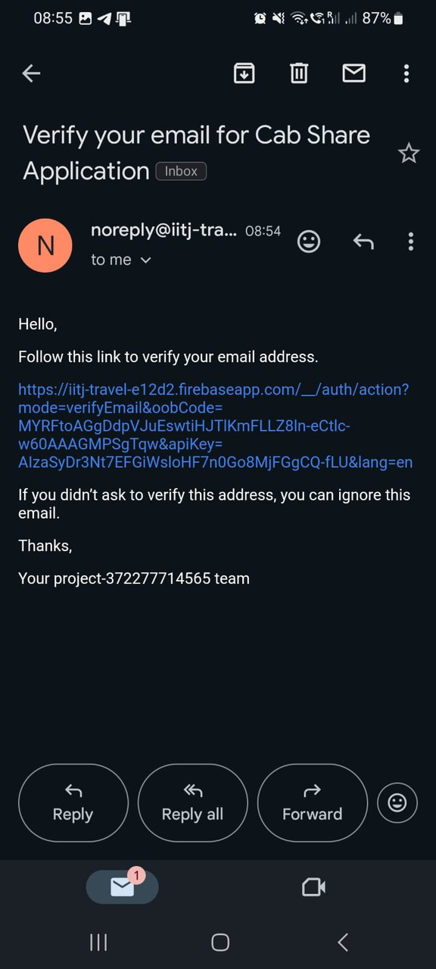
Confirmation Email

Slide 9
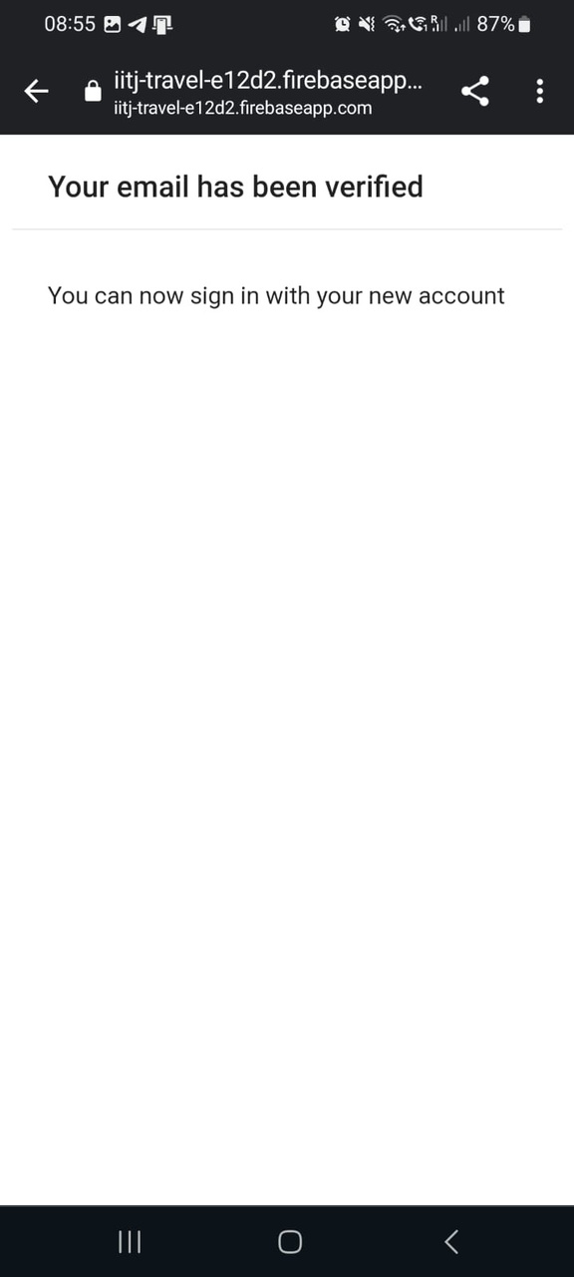
Verification Message

Slide 10
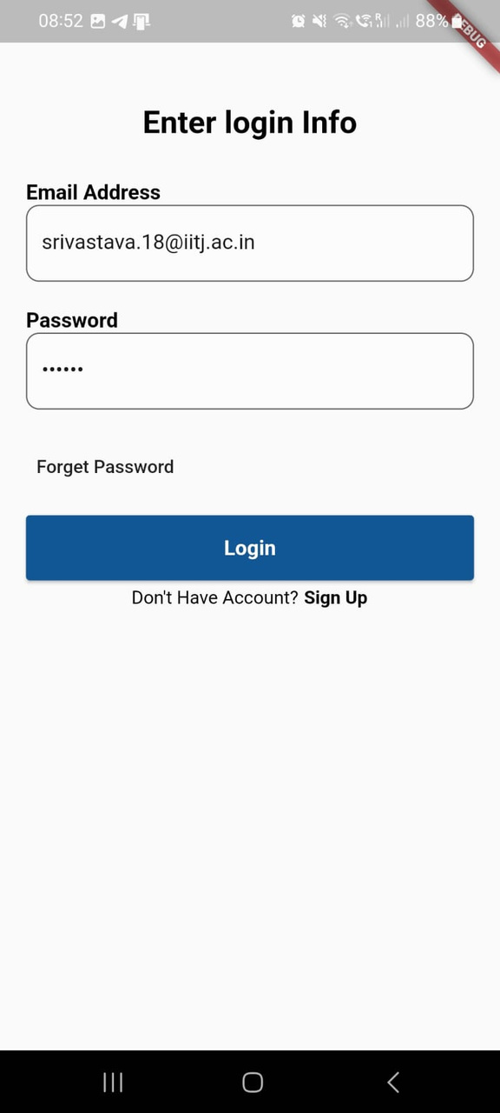
Login Page

Slide 11
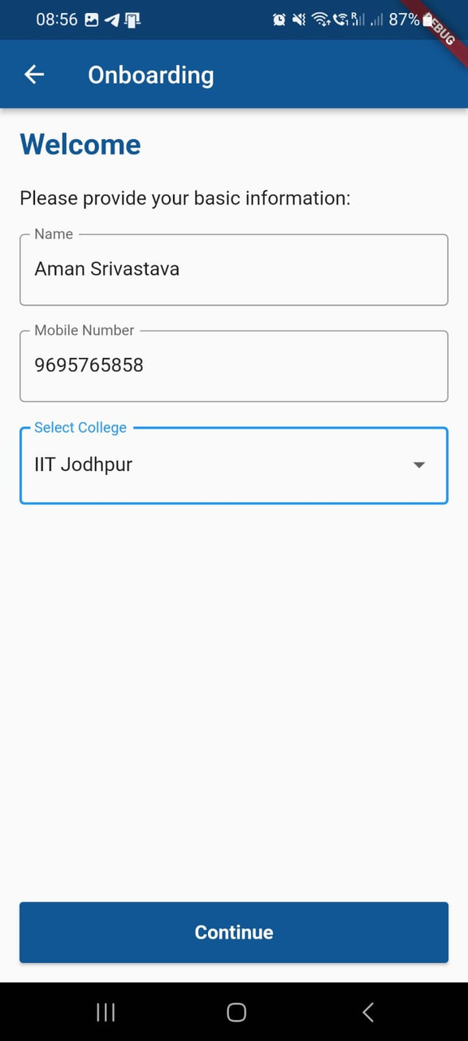
Onboarding Page

Slide 12
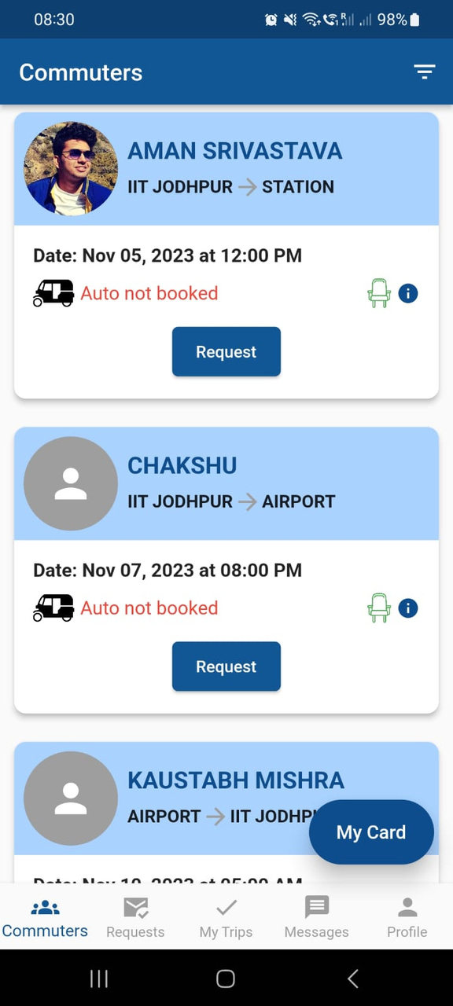
Homepage

Slide 13
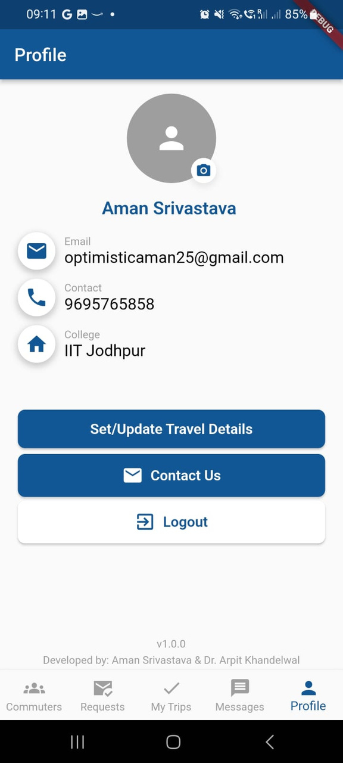
Profile Page

Slide 14
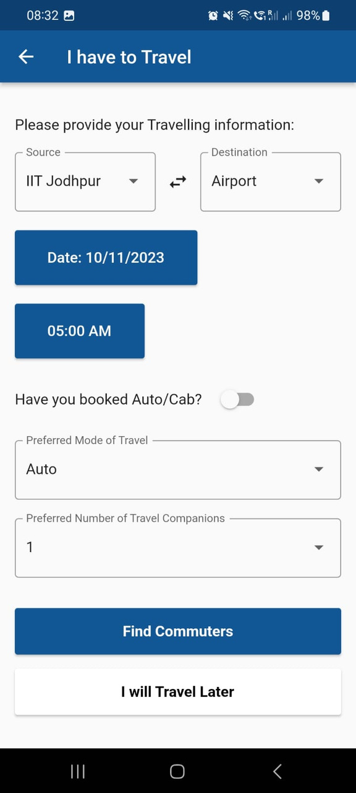
Set Travel Details

Slide 15
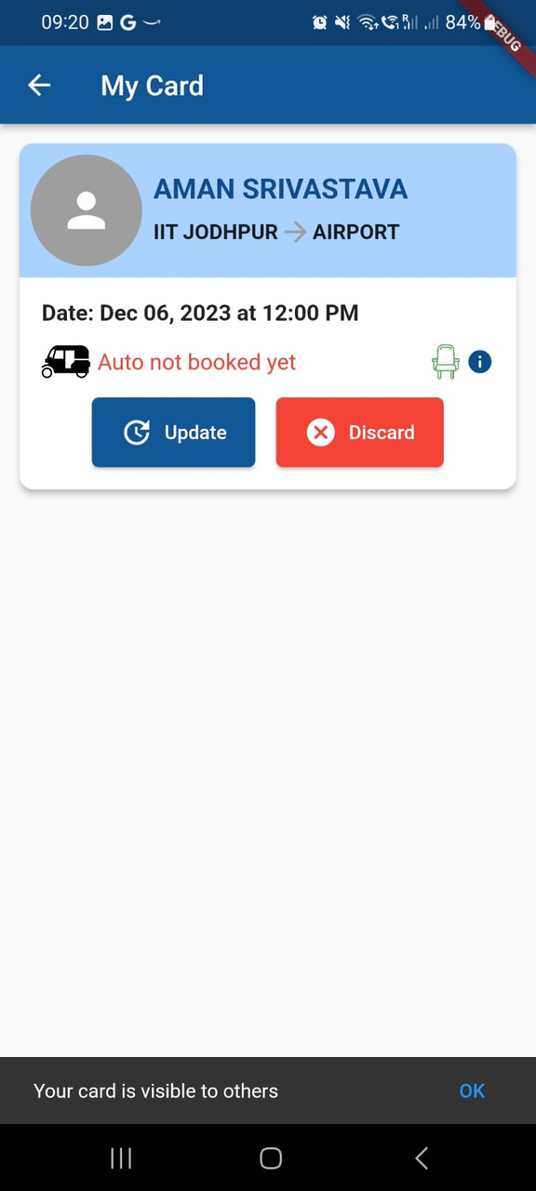
Product
or service
Write an intriguing summary
of what your company does.

Slide 16
Sending Request

Slide 17
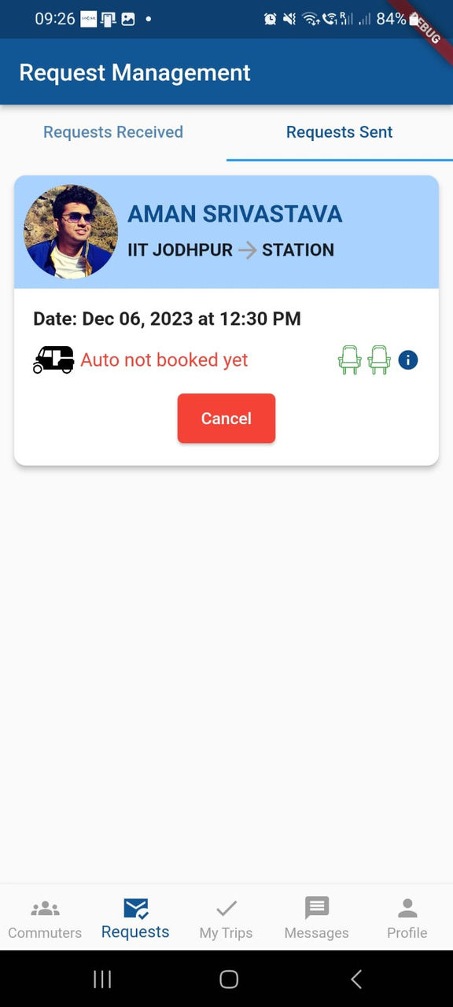
Sent Requests

Slide 18
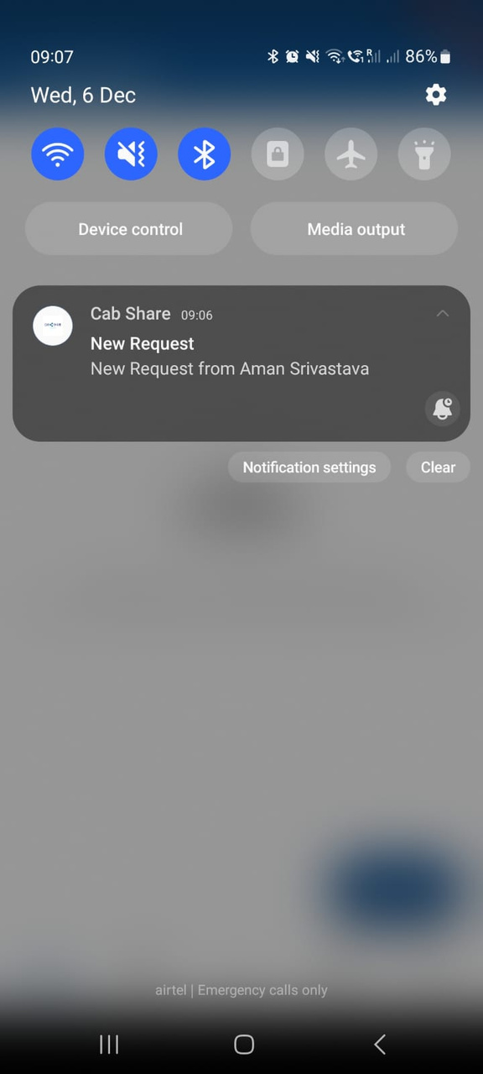
Notification
=

Slide 19
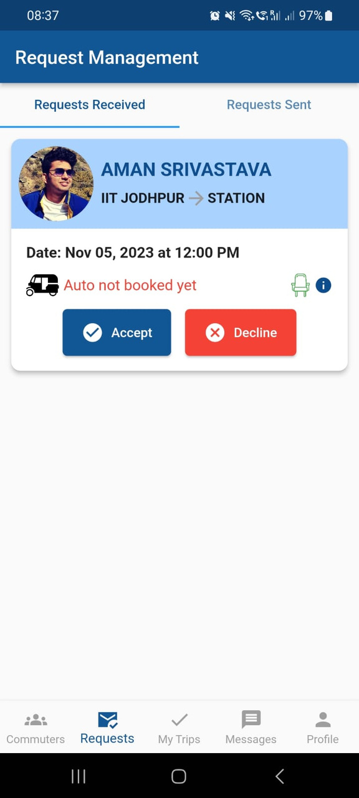
Request Recieved
=

Slide 20
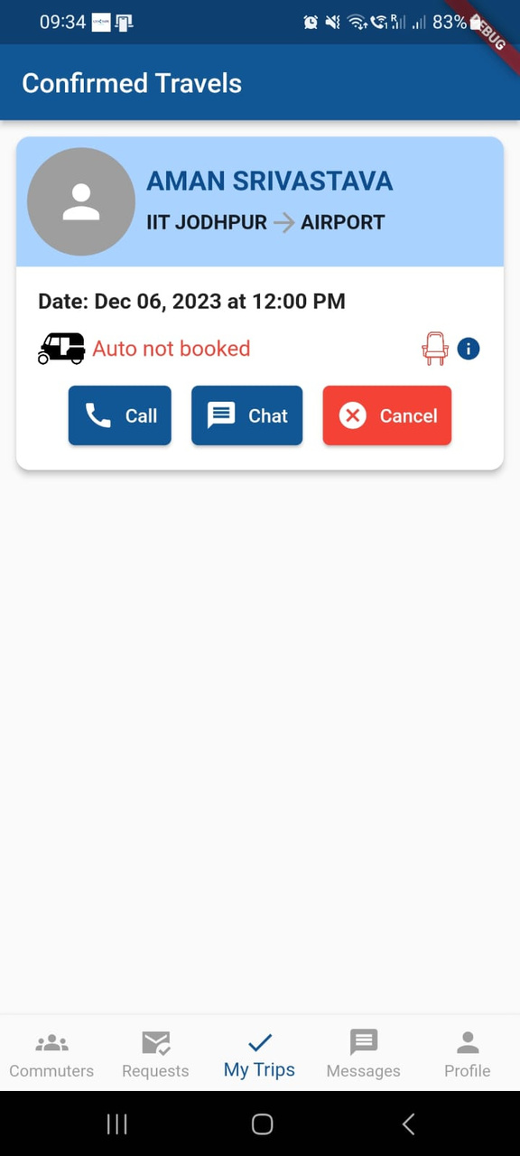
Confirmed Travels
=

Slide 21
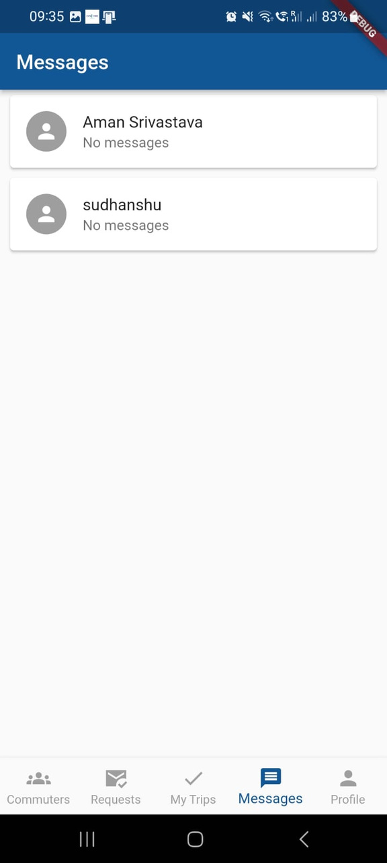
In-app messaging
=

Slide 22
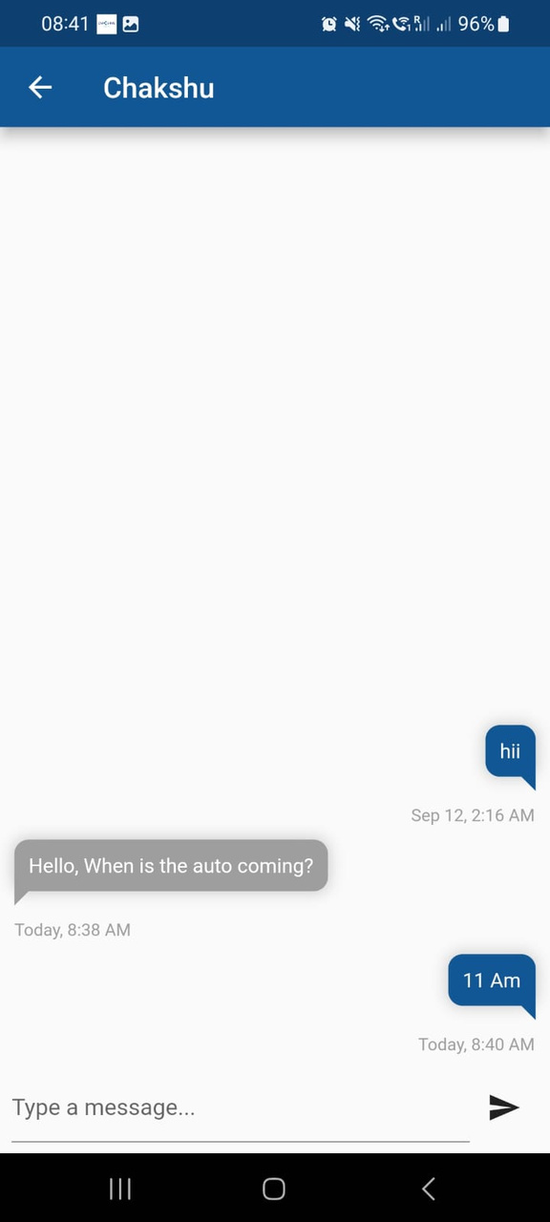
In-app messaging
=

Slide 23
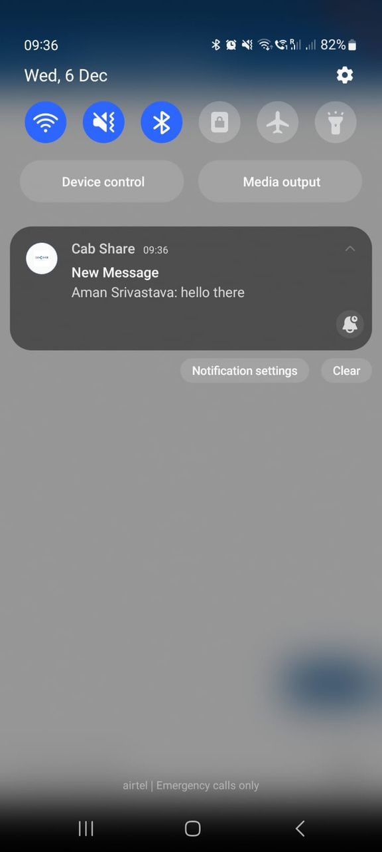
Message Notification

Slide 24
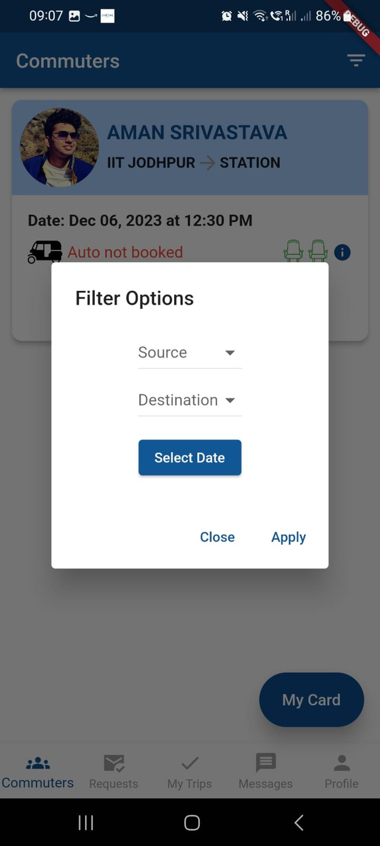
Filter Options
=

Slide 25
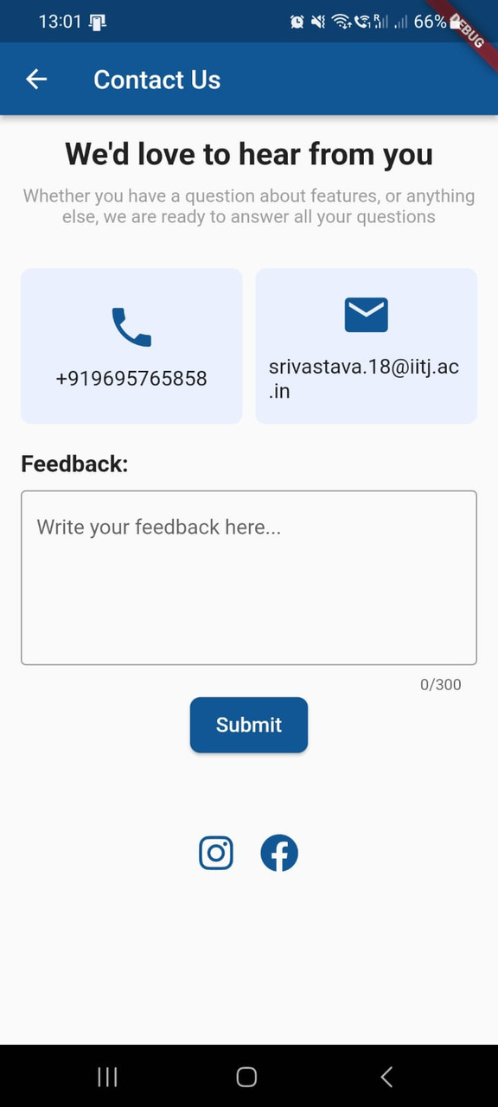
Feedback
=

Slide 26
Timeline of the Project
Timeline highlighting the project's progress in four parts: August, September, October, and November.
August
September
October
November
Conceptualization and Research
Planning and Design
Initial Developement
Frontend Development
Feature Implementation
Testing Phase
Refinement and Optimization
Feature Enhancement
Integration and Further Testing
Finalization
Launch Preparation

Slide 27

Auto Drivers Integration
Future Enhancements
Payment Integration
Feedback Options
Google Map Integration and Real Time Updates

Slide 28
Hand on experied on flutter
Lesson Learned
Importance of feedback from users

Slide 29
Thank You

